Slide 1


2014
Illinois Farmland Values
& Lease Trends
Dale E. Aupperle, AFM, ARA General Chairman | Gary Schnitkey, Ph.D. Head – Survey Group

Slide 2
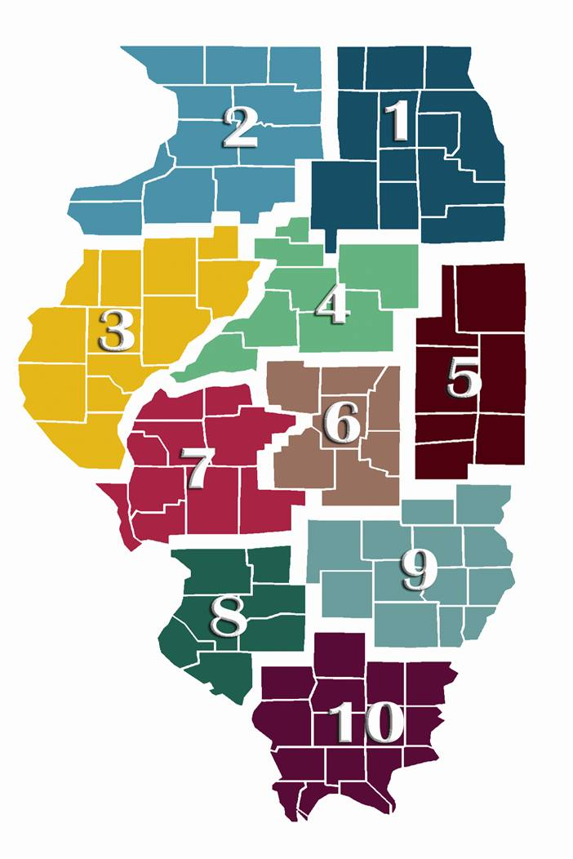
2014
Illinois Farmland Values & Lease Trends
▼ | 19th Annual Report
▼ | Covers Calendar Year 2013
▼ | Lots of Farm Real Estate Transactions
▼ | Updates on Rents & Leasing Trends
▼ | A Team of Over 70 Professionals Professional Farm Managers Accredited & State Certified Appraisers Licensed Farmland Brokers
All Sharing Real World Experiences!

Slide 3


Contributing Organizations
Illinois Society of Professional Farm Managers and Rural Appraisers
University of Illinois College of ACES
Illinois Farm & Land Chapter of the REALTORS Land Institute

Slide 4








It Takes a Team of Professionals
General Chair Dale Aupperle, AFM, ARA Heartland Ag Group, Ltd. 1401 Koester Drive, Ste. 100 Forsyth, IL 62535 (217) 876-7700
Head – Survey Group Gary Schnitkey, Ph.D. University of Illinois 300A Mumford Hall 1301 W. Gregory Drive Urbana, IL 61801 (217) 244-9595
Regional Data Group Daniel A. Davis, AFM, ARA Arch Ag LLC 2 Owl Nest Lane Columbia, IL 62236 (618) 939-4560
Regional Data Group Bruce Sherrick, Ph.D. University of Illinois College of ACES 1301 W. Gregory Drive Urbana, IL 61801 (217) 244-2637
Regional Data Group Charles Knudson, ARA, RPRA 1st Farm Credit Services 2005 Jacobssen Drive, Ste. C Normal, IL 61761 (309) 268-0286
Advertising Group Jonathan Norvell, Ph.D., AFM University of Illinois 506 S. Wright Street Urbana, IL 61801 (217) 244-6352
Land Values Conference Tim Harris, AFM Capital Ag Property Services 22263 1365 N. Avenue Princeton, IL 61356 (815) 875-7418
Land Values Conference Winnie Stortzum, ARA Farmers National Co. 109 E. Main Street Arcola, IL 61910 (217) 268-4434

Slide 5






It Takes a Team of Professionals
Region 1
Douglas Deininger, ALC
Capital Ag Property Services
25846 Meadowland Circle
Plainfield, IL 60585
(630) 258-4801
Region 2
David Dinderman
1st Farm Credit Services
705 E. South Street
Freeport, IL 61032
(815) 235-3171
Region 2
Todd Slock
1st Farm Credit Services
3184 North State Route 23
Ottawa, IL 61350
(815) 433-1780
Region 3
Herbert Meyer, ARA
1st Farm Credit Services
PO Box 70
Edwards, IL 61528
(309) 676-0069
Region 4
David E. Klein, AFM, ALC
Soy Capital Ag Services
#6 Heartland Dr., Ste. A
Bloomington, IL 61702
(309) 665-0961
Region 5
Mac Boyd, ARA
Farmer National Co.
109 East Main Street
Arcola, IL 61910
(217) 268-4434
Notes:
5

Slide 6





It Takes a Team of Professionals
Region 6
Dean G. Kyburz
Busey Ag Services
130 North Main Street
Decatur, IL 62523
(217) 425-8290
Region 7
Thomas Toohill, AFM
Soy Capital Ag Services
3151 Greenhead Drive, Ste. A
Springfield, IL 62707
(217) 547-2885
Region 8
Dale Kellermann, AFM
Hickory Point Bank & Trust
1400 S. Lincoln Ave., Ste. G
O’Fallon, IL 62269
(618) 622-9490
Region 9
David M. Ragan
Farm Credit Services of Illinois
1506 E. Lafayette Ave.
Effingham, IL 62401
(217) 342-6640
Region 10
Phil Eberle
112 N. Lark Lane
Carbondale, IL 62901
(618) 457-0574
Notes:
6

Slide 7
About This 2014 Booklet:
▼ | Our Second Full Color Presentation (Thanks Carroll Merry)
▼ | Presented by 10 Regions Farmland Sales Data ▪ Excellent Productive Tracts ▪ Good Productive Tracts ▪ Average Productive Tracts ▪ Fair Productive Tracts ▪ Recreational Tracts ▪ Transitional Tracts Lease Trends & Rental Rates
▼ | Our Sponsors & Advertisers - A good place to find a professional!
▼ | Special Articles - Farmland Prices Decline in 2013 - Cash Rent Levels Decrease Impacts of Recent Changes in the Illinois Farmland Assessment Act Potential Impact of Alternative RFS Outcomes on Biofuel and Grain Markets

Slide 8
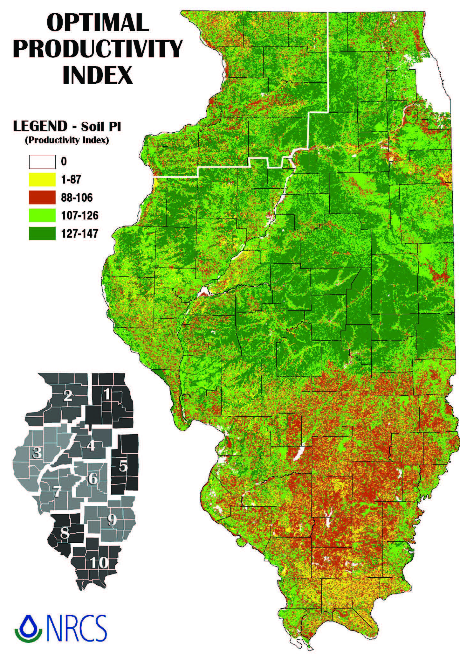
2014
Illinois Farmland Values
& Lease Trends
Understanding Our Farmland Categories Using the Productivity Index from the University of Illinois (Bulletin 811).
Excellent Productivity – | 147 to 133
Good Productivity – | 132 to 117
Average Productivity – | 116 to 100
Fair Productivity – | Less than 100

Slide 9
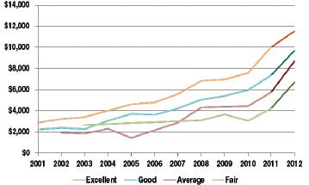
A Special Report Feature
We have added a chart that tracks the value of each category of land over time.
Region 6 Land Values Summary Chart: 2001-2012
Regional Data Group Bruce Sherrick, Ph.D. University of Illinois College of ACES 1301 W. Gregory Drive Urbana, IL 61801 (217) 244-2637
Thanks - - Dr. Sherrick

Slide 10
2013 – Results at a Glance
Farmland earnings are important! Sharply lower grain prices diminish earnings projections - - putting the brakes on the uptrend.
Land Category | Mid Range 2013 Change | Comments
Excellent | -2% | Pressure on profits made land values softer as the year ended. Less participants but still willing buyers!
Good | -3% | Mostly farmer buyers. Increased input costs are a concern. Wide range in offerings and values.
Average | -4% | Buyers were likely to be neighbors in the community. The higher risk of lower yields impacted the northern regions. In the southern region, farmer buyers kept values steady to higher.
Fair | -7% | Popular category as land mix attracts residential, recreational and non-farm uses. Somewhat softer values.
Recreational | Steady to stronger | Steady to stronger values in northern and southern Illinois. Steady volume - - spotty values in Central Illinois.
Transitional | Steady | Increased activity near metropolitan centers. Generally – current farmland values nearly equal to development land values.

Slide 11
All Categories of Farmland
The Great State of Illinois
These (rounded) figures are the average as reported by each region on the categories shown.
 | Excellent | Good | Average | Fair | Recreational | Transitional
Region 1 | $12,700 | $9,100 | $9,300 | - - | $6,000 | $25,400
Region 2 | $12,900 | $10,000 | $7,100 | $5,900 | $4,300 | $17,500
Region 3 | $13,600 | $9,500 | $6,900 | - - | $3,400 | - -
Region 4 | $12,300 | $9,500 | $7,600 | $8,700 | $4,500 | $25,000
Region 5 | $11,500 | $9,100 | $7,000 | $4,400 | $3,100 | $7,500
Region 6 | $12,600 | $9,900 | $8,100 | $7,200 | $2,900 | - -
Region 7 | $12,900 | $10,000 | $6,800 | - - | $3,300 | $37,600
Region 8 | - - | $10,300 | $9,200 | $7,500 | $3,900 | $10,100
Region 9 | - - | $9,400 | $7,900 | $5,900 | $3,000 | $16,300
Region 10 | - - | $10,000 | $5,600 | $4,200 | $2,700 | - -
Average | $12,600 | $9,700 | $7,500 | $5,850 | $3,700 | $19,900
Averages are dangerous - - but they give us a snapshot of each category (for comparison).

Slide 12
2013 Excellent Quality Farmland
The prices shown below are the averages reported by each region.
 | Mid Range Land Value | Comments
Region 1 | $12,700 | Made up for last year’s softness - - mainly farmer buyers - - finished strong.
Region 2 | $12,900 | Purchasers were local farmers - - this category is stable and will be the last of the categories to see a pull back in values.
Region 3 | $13,600 | Prime land has shown strength at auction. Highest sale was $20,500 per acre.
Region 4 | $12,300 | Best farms led the way to more record highs at auctions. Good drainage pays. 40 to 160 acres brought highest price. Neighbor bidding - $16,000 per acre!
Region 5 | $11,500 | Less properties available for purchase - - first quarter record high prices - - values declined into year-end. Farmers were not sellers.
Region 6 | $12,600 | Farming families were buyers - - fewer buyers at auction as year progressed. Land values were weak during the 4th quarter and finished lower on the year.
Region 7 | $12,900 | Strong Demand for excellent quality - investors with ties to aggressive farmers still buying.
Region 8 | - -
Region 9 | - -
Region 10 | - -
 | $12,600 | (average)

Slide 13
2013 Good Quality Farmland
The prices shown below are the averages reported by each region.
 | Mid Range Land Value | Comments
Region 1 | $9,100 | Increasing crop input costs caused farmers to be more conservative buyers.
Region 2 | $10,000 | Local farmer buyers more heavily discounted wooded and pasture ground. Buyers preference shifting to excellent quality tracts due to yield differences.
Region 3 | $9,500 | Pronounced value difference regarding time to farm, field shapes, topography. Larger farmers shy away.
Region 4 | $9,500 | Lower supply of land on market - - adequate buyer demand - - wider range in values.
Region 5 | $9,100 | Wide variation in sales prices - - investors anticipated higher cash returns - - farmers were aggressive buyers.
Region 6 | $9,900 | Wide range in the size of tracts being sold.
Region 7 | $10,000 | Southern counties in region held up best as year-end values softened.
Region 8 | $10,300 | Southern Illinois has limited soils above 133 productivity index - - strong prices on tracts that sold.
Region 9 | $9,400 | Most soils are below 115 in productivity - - few sales in this category.
Region 10 | $10,000 | Less than 7% of land in this category. Sales due to estates or retirements. Farmer buyers.

Slide 14
2013 Recreational Land
The prices shown below are the averages reported by each region.
 | Mid Range Land Value | Comments
Region 1 | $6,000 | Stronger values – declining deer population (disease) reducing interest. County forest preserves running out of funds.
Region 2 | $4,300 | Supply of land is significant - - exceeding demand. Buyers are from the eastern portion of the state. Tracts sell better with realtors.
Region 3 | $3,400 | Non-farming motivated buyers. Broker assisted sales were strong. Auction sales demonstrated weakness.
Region 4 | $4,500 | Steady volume of tracts sold – markets softened over 15 miles out from population centers. Tract size is important.
Region 5 | $3,100 | Demand was slow because of the overall poor economy - - only a few properties for sale. Wide range in prices.
Region 6 | $2,900 | Steady volume of land - - prices down approximately 10%.
Region 7 | $3,300 | Low percentage tillable land demonstrates premiums - - used for pasture, timber, or recreation. Steady prices
Region 8 | $3,900 | Most tracts sold are either mostly or completely wooded. Non-farmer and hunter buyers. Good demand around metropolitan areas.
Region 9 | $3,000 | Slight increase of value. Small irregular shape fields. No correlation to productivity levels.
Region 10 | $2,700 | Realtors represent sellers - - primary use is deer hunting. Mainly low quality pasture and wooded land. Prices up slightly.

Slide 15
2013 Transitional Land
 | Mid Range Land Value | Comments
Region 1 | $25,400 | Increased activity levels - - higher values - - transactions were related to rail/truck transportation of cargo containers and mining silica sand used in oil well fracking.
Region 2 | $17,500 | Few properties sold to buyers with intention of building. Limited number selling adjacent to subdivisions at farmland values (no premium).
Region 3 | N/A | Limited activity - - sports dome complex could spur activity north of Peoria. Washington tornado could spur new housing.
Region 4 | $25,000 | Limited number of sales.
Region 5 | $7,500 | Weaker demand because of generally poor business climate.
Region 6 | N/A | No sales reported.
Region 7 | $37,600 | On the threshold of a comeback for this type of land. In general, agricultural land prices still equaling transitional prices.
Region 8 | $10,100 | All sales were within the city limits – do not reflect values above farmland - - some tracts were lower than farmland.
Region 9 | $16,300 | Minimal activity for transitional land. Prices stable.
Region 10 | N/A | No activity.

Slide 16
2013 River Bottom Land
Here is a special focus on River Bottom land sales:
 | Mid Range Land Value | Comments
Region 9 | $5,500 | Prices vary greatly depending on flood protection, location, ease of access, and potential for irrigation. Nine excellent sales in six counties in this region.

Slide 17
Special Interest Stories
Our members across Illinois have unique transactions occurring in their communities. Let’s take a look:
Region 2 | Adkins Energy LLC will construct a $4.5 biodiesel plant (2 million gallon a year capacity) in 2014.
Region 3 | 1,433 acres was auctioned in December 2013 in McDonough/Warren County. Lot of land on the market at once! Final price was just over $11,700 - - a market absorbed it.
Region 4 | A highly desirable farm at Arrowsmith was auctioned to a local farm family at $14,000 per acre. There were three turbines in the property.
Region 5 | A 960 acre patterned tile (Class A) in Douglas County (with 65,000 bushel of grain storage) sold at public auction for $14 million ($14,583 per acre). Largest contiguous tract sold in county - - an investor buyer!
Region 8 | A 376.41 acre improved reclaimed mine site near Freeburg sold in November for $1 million ($2,656 per acre). This was the area where coal is brought to the surface to be processed.

Slide 18
Here is the good stuff - -
First hand observations from across the great state of Illinois!
▼ | Net Farm Income – Farmland is what it earns! Lower corn and soybean prices will reduce net farm income by over 20% in 2014. Crop insurance payments are marginalized! We could have some tough earning years in front of us.
▼ | Return on Investment – The usually competitive return on farmland investments is diminished below the traditional 3½ - 4% results. Farmland values have gone up faster than net farm income.
Notes:
18

Slide 19
Here is the good stuff - - (continued)
▼ | Alternative Investments – Agriculture is always competing with other financial opportunities. As farmland’s performance levels off - - the competition from other financial assets is enhanced. Money could leave agriculture at some point.
▼ | Tile Drainage – Drainage can be one of the most important enhancements to Illinois soils. Farmers continue to redirect their profits into expanded tile drainage systems on their farms. The reduction of the IRS tax benefit in 2014 may slow down future projects.
Notes:
19

Slide 20
Here is the good stuff - - (continued)
▼ | Interest Rates – Interest rates on operating loans and farm mortgages are critical to profitability. Long term mortgage interest rates ticked up this year. The Federal Reserve actions may precipitate higher interest rates for agriculture.
▼ | Livestock Industry – Livestock farmers have enjoyed enhanced profitability through higher prices and reduced feed costs. They have competed vigorously for additional land purchases with their profits.

Slide 21
Here is the good stuff - - (continued)
▼ | Auction Sales – The process of auctioning farmland is one of price discovery. As commodity prices and net income declined - - there were fewer bidders at auctions and an increasing number of no sale transactions. Over 50% of the farms sold at auction.
▼ | Tax-Free Exchanges – This popular method of avoiding capital gains taxes is starting to resurface in Northern Illinois where some farmers are selling prime farmland and buying back development land for future opportunities.

Slide 22
Here is the good stuff - - (continued)
▼ | Large Tracts – A contiguous 960 acre tract of Douglas County land sold at public auction in November 2013 for a record price of $14,583 per acre. The buyer was an investor. In December a 1,354.6 acre Crawford County bottom farm on the Embarrass River sold for $5,869 per acre.
▼ | Ethanol’s Future – Farmers and landowners are concerned about the EPA regulations which could affect the renewable fuel standard. A lot of our corn usage is dependent on a vibrant ethanol industry moving forward.

Slide 23
Here is the good stuff - - (continued)
▼ | Grain Handling Facilities – Central Illinois reports ongoing expansion of major grain handling facilities to move our increasing corn and soybean production to end users.
▼ | Conservation and Stewardship – There are numerous reports of ongoing stewardship activities to control runoff of farm chemicals and fertilizers to prevent contamination of our lakes and streams. Positive agricultural and suburban collaboration is ongoing.

Slide 24
Here is the good stuff - - (continued)
▼ | Wind Energy – The market for green energy is still uncertain causing many projects to be placed on hold. Various parts of Illinois have excellent wind speeds for electricity generation.

Slide 25
Uptrend Interruptions
In the last four decades the Illinois farmland uptrend was interrupted on three occasions:
Years 2008 – 2009 | Sideways for a year - - after doubling in value from 2001.
Years 1998 – 2001 | A 15% correction - - after an eleven year uptrend from 1997 with farmland values rising by 92%
Years 1980 – 1987 | A 50% correction - - after farmland values advanced nearly 500% from 1982. This one was a bubble.
In summary – Perhaps history gives us some guidelines for our current thought processes. It doesn’t look like a bubble to us!

Slide 26
A Quick Look Forward
▼ | Influencing factors to watch for:
 | - | Commodity Prices |  |  | - | Value of the Dollar
 | - | Weather and Yields |  |  | - | Alternative Investments
 | - | Interest Rates |  |  | - | Long Term Inflation
 | - | Net Farm Income |  |  | - | Ethanol
▼ | Late Breaking Farmland Sales: The rally in commodity prices in February/March has taken the pressure off of land values.
 | - |  | Aledo, IL | $16,250 |  |  | per acre
 | - |  | Clinton, IL | $14,361 |  |  | per acre
 |  |  |  | $11,973 |  |  | per acre
 | - |  | Mt. Zion, IL | $7,400 |  |  | per acre

Slide 27
Land and Lease Survey
Surveys of individuals knowledgeable about the farmland and farmland rental markets
Land Survey (page 82)
  Prices at a crossroad, moving from a rising price environment to a more stable (perhaps declining) market
Lease Survey (page 85)
  Cash rent steady to slight decreases with possibility of more decreases into 2015

Slide 28
Farmland Prices
Land Quality | Jan 1, 2013 | Dec 31, 2013 | Change
Excellent | $13,100 | $12,800 | -2%
Good | $11,100 | $10,800 | -3%
Fair | $9,100 | $8,700 | -4%
Poor | $7,100 | $6,600 | -7%

Slide 29
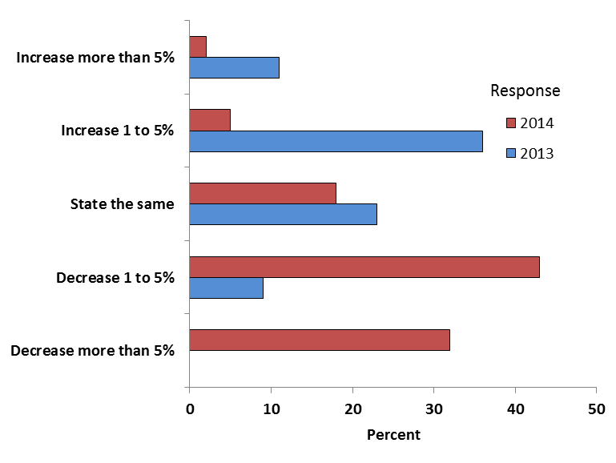
Percent of Members Expecting Farmland Price Increases in 2013 and 2014

Slide 30
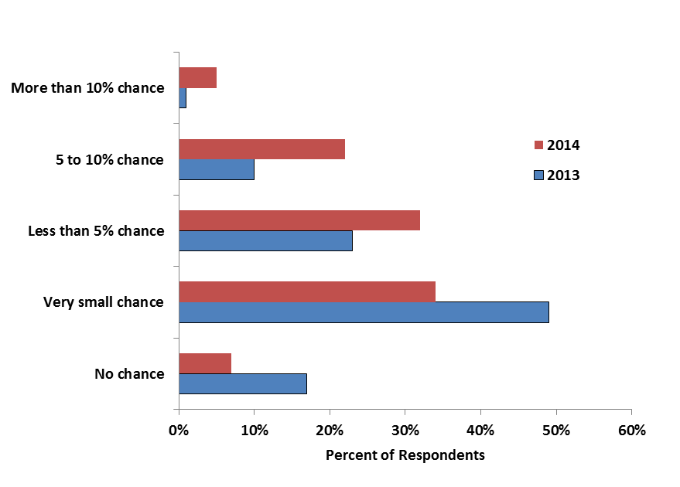
Chance of a 20% Price Decline

Slide 31
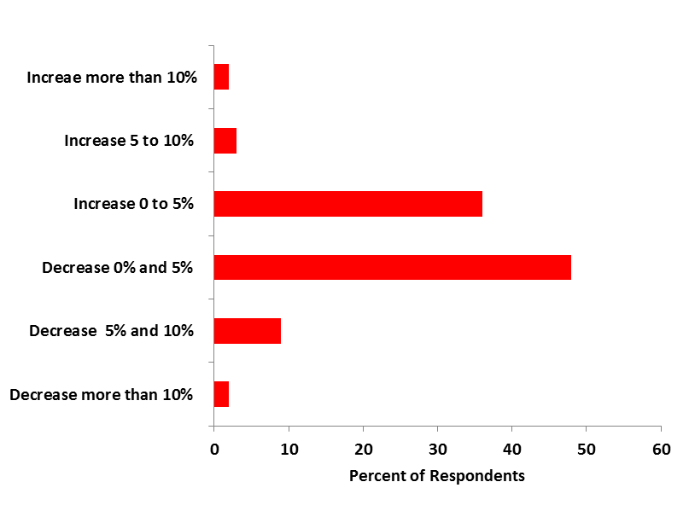
Expected Yearly Increase in Land Prices,
Next Five Years

Slide 32
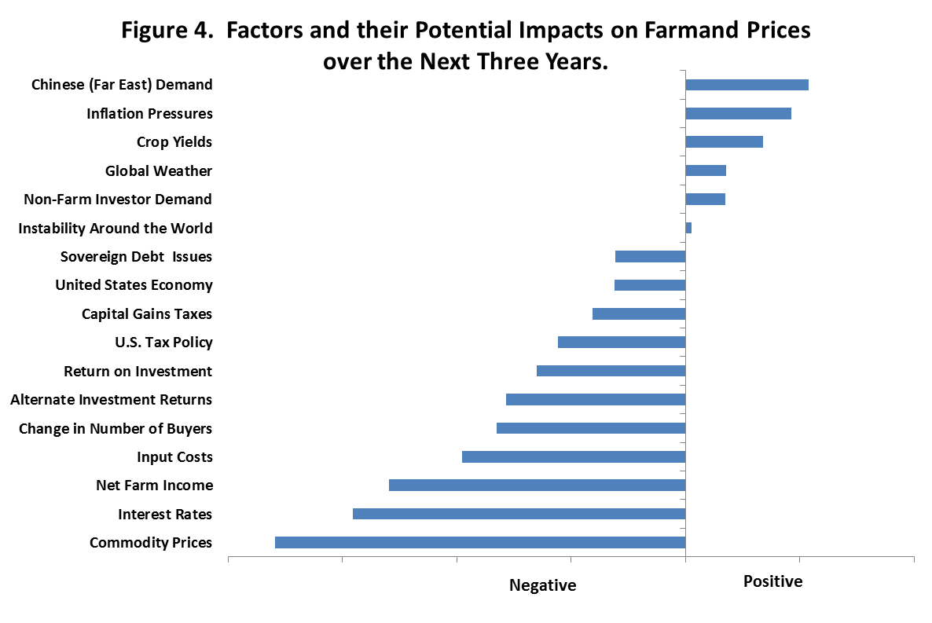

Slide 33
Buyers and Sellers
Buyers: Local farmers 64%, Local investors 14%, Non-local investors 9%
Sellers: Estate sales 52%, Individual investors, 14%, Retired farmers 11%
Reasons for Selling: Settle estates 50%, Received a good price 22%

Slide 34
Method of Selling Farmland

Slide 35
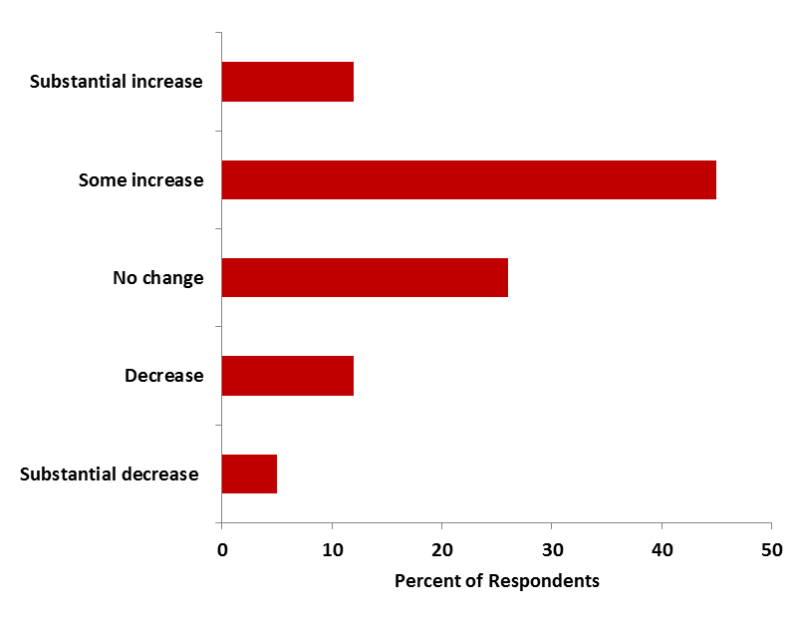
Change in Volume, Last Half 2012 to 2013

Slide 36
Incomes from Alternative Lease Types, 2013

Slide 37
2014 Cash Rents, Professional Farm Managers

Slide 38
Historic Cash Rents, Midpoints

Slide 39
Cash Rent Expectations for 2015
Expectations for lower returns into 2015
If yields are normal, $3.50 corn price, $10 soybean price
  92% expect cash rents to decrease $10 per acre or more
  4% expect cash rents to decrease $0 to 10 per acre
  4% expect cash rents remain the same
  0% expect cash rents to increase

Slide 40
Thank You and Questions

