Slide 1
What’s Next for Farmland in the Midwest?
2014 Illinois Land Value Conference
Illinois Society of Professional Farm Managers and Rural Appraisers
Bloomington, IL
March 20, 2014
by
Brent Gloy
Director, Center for Commercial Agriculture
Bgloy@purdue.edu
Twitter: @BrentGloy

Slide 2

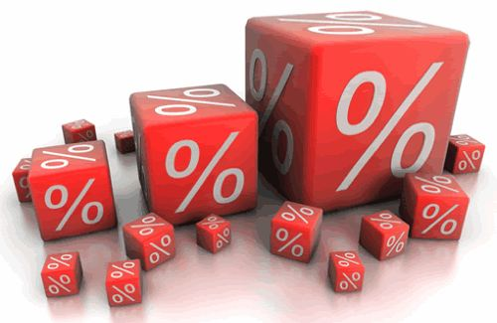
Preamble: What Drives Value?
Capital asset values are determined by EXPECTATIONS of the level of
future earnings and their
present value
  Earnings are difficult to forecast
  Interest rates and inflation drive present values and are equally difficult to forecast
Notes:
Capital assets are prone to bubbles because their value is dependent upon future earnings and interest rates. Both can be difficult to project but particularly today and in periods of rapid change. Additionally, the herd mentality tends to push people to one extreme thinking all things always go up or all things always go down. This is the danger zone.

Slide 3

These Times Haven’t been Good They’ve Been SPECTACULAR!

Slide 4

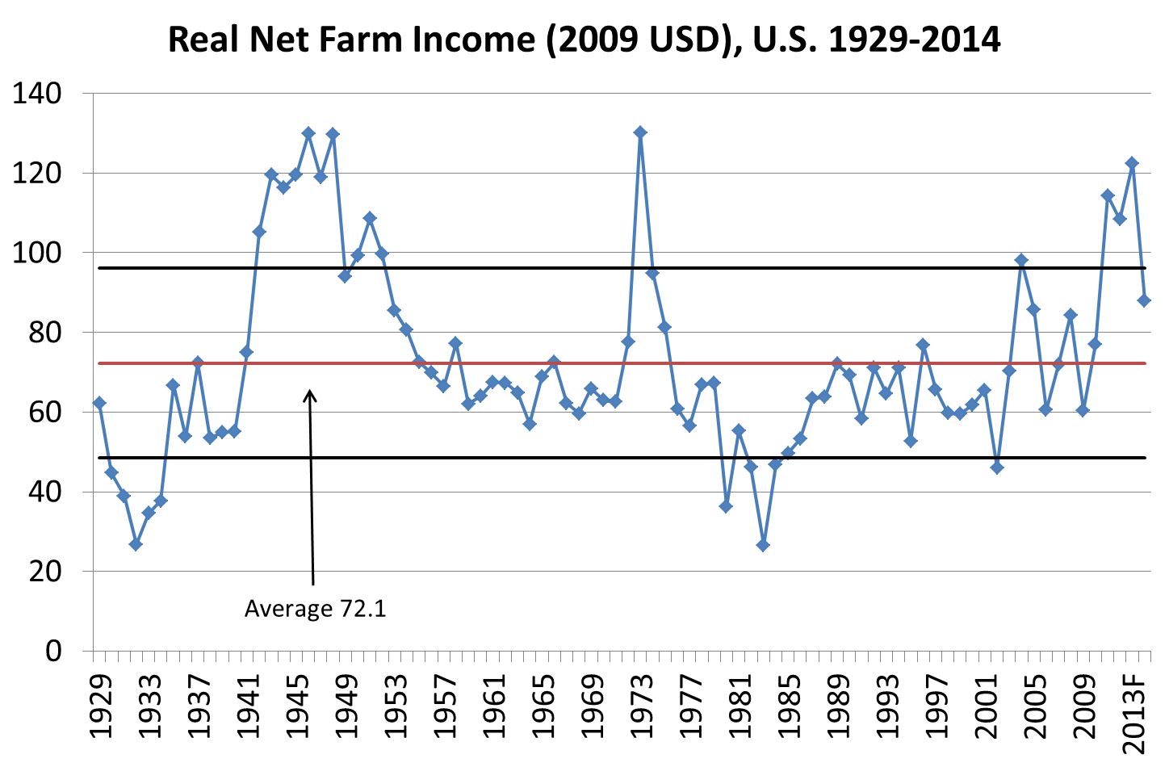
Farm Incomes Likely to Fall From Historic Highs but Not to Historic Lows

Slide 5
In Real Terms, Today’s Farmland Value Increases Exceed those of the 70’s
Region | Nominal Change Annualized Growth Rate | Real Change and Annualized Growth Rate
Iowa | --------------------------------Percent ----------------------------
1971-1981 | 410 | 127
 | 17.7 | 8.6
2003-2013 | 317 | 231
 | 15.4 | 12.7
Illinois
1971-1981 | 342 | 97
 | 16 | 7
2003-2013 | 220 | 154
 | 12 | 9.8
Indiana
1971-1981 | 381 | 114
 | 17.0 | 7.9
2003-2013 | 168 | 113
 | 10.4 | 7.8
ª Changes in farm real estate values from National Agricultural Statistics Service. Real values calculated using the CPI index.

Slide 6
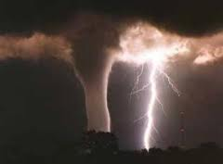
The Perfect Storm
Biofuels
Emerging market demand
Poor weather
Low interest rates
Key question is now whether the future
looks similar, better, or worse
Could the Great Boom Be Coming to an End?

Slide 7

Could the great boom be coming to an end?
The Headwinds
Lower commodity prices and margin compression
Biofuel growth ends
Sluggish global economy – watch emerging markets
Global supply response
Overhang of potential for increased interest rates
Slow cash rental adjustment

Slide 8
Farm Booms Always End.
How they end is the concern.

Slide 9
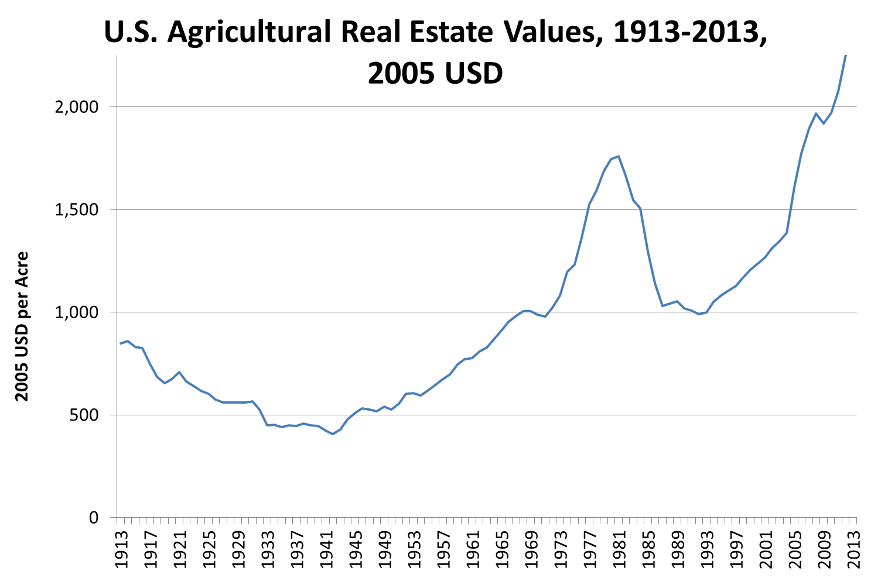
Great Depression
WWII productivity growth
Financial crisis and productivity catch up
Gov payments and productivity
Biofuels and demand expansion in emerging economies
Demand expansion

Slide 10
What Causes Booms to End Poorly?
Dramatic reduction in demand (1980s) particularly exports, but now watch out for RFS
Over response on the supply side coinciding with #1
Too much leverage
Turmoil in broader economy
If we can keep these from happening we likely can have a soft landing. Problem: Of the 4 we only control #3 and can potentially influence #1 through policy

Slide 11


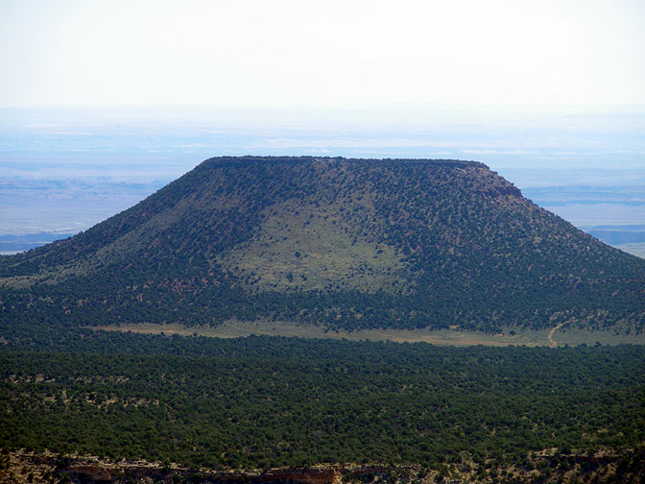
Where to in the Land Market?

Slide 12

What are the Keys Going Forward?
Interest rates/cap rates
Demand growth
  Biofuels
  Emerging markets/trade
Supply response
  Weather
  U.S.
  Rest of the world
Leverage choices

Slide 13
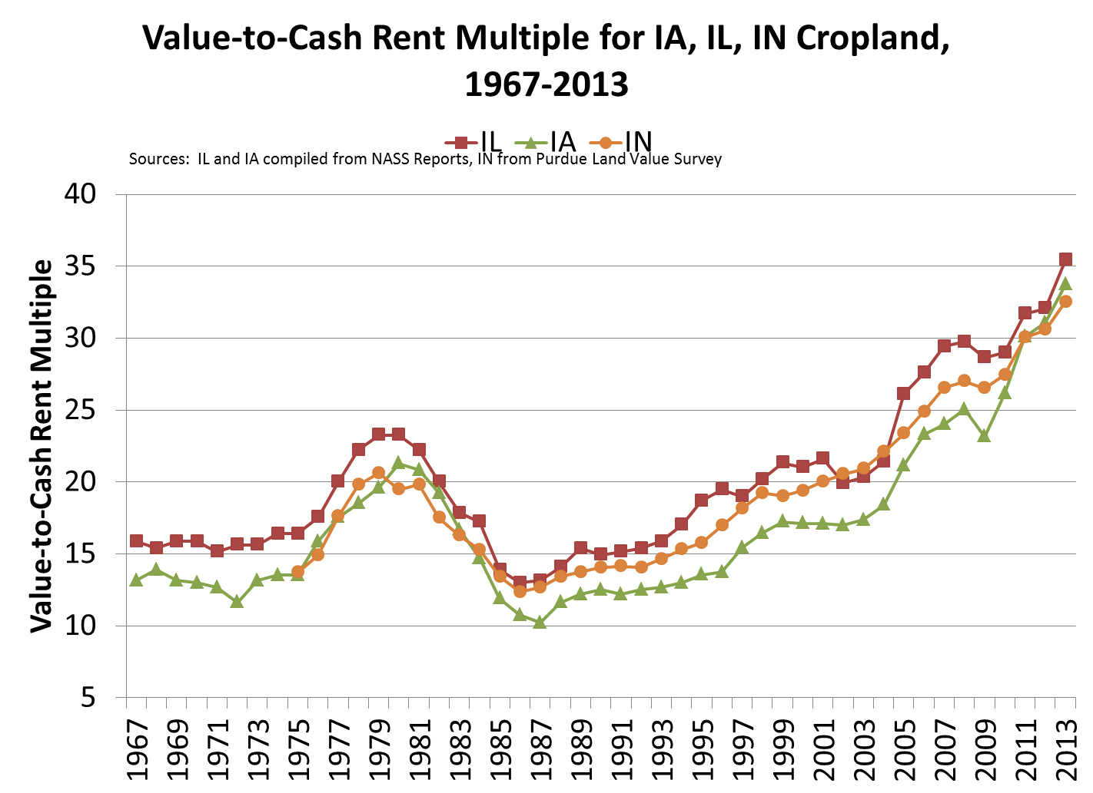

Slide 14
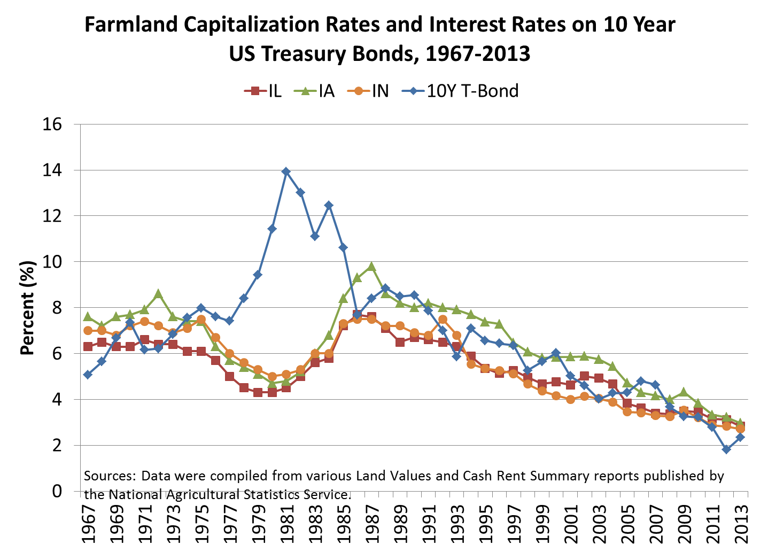

Slide 15
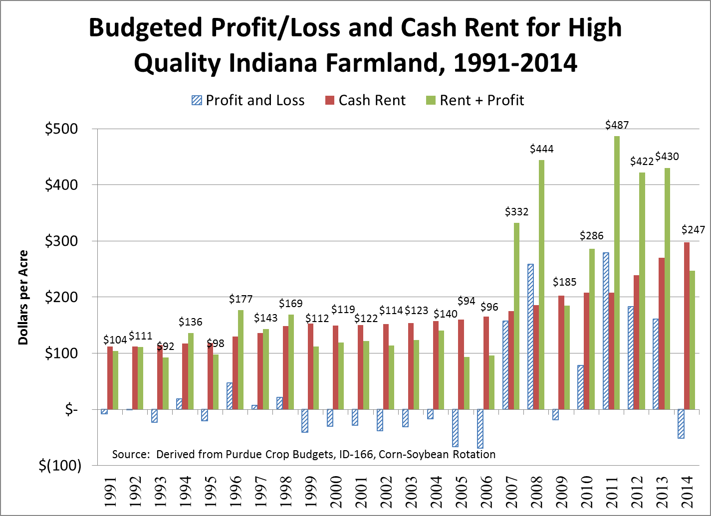

Slide 16
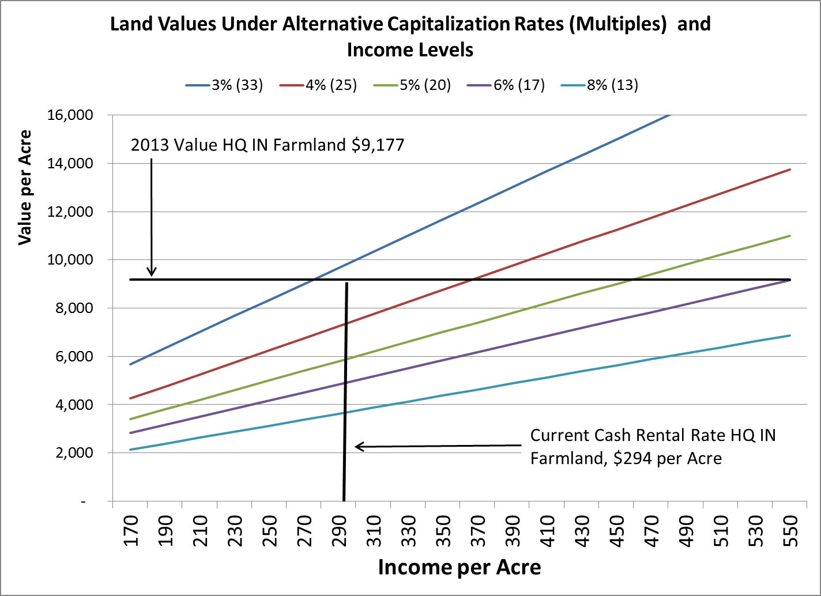

Slide 17
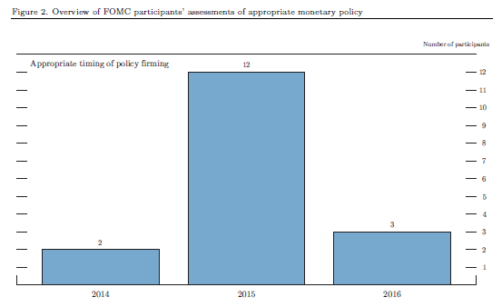
Eventually 2015 will get here! Expect lots of gyrations and angst ahead of tightening!
Source: Board of Governors of the Federal Reserve System, December 18, 2013
http://www.federalreserve.gov/monetarypolicy/files/fomcprojtabl20131218.pdf

Slide 18
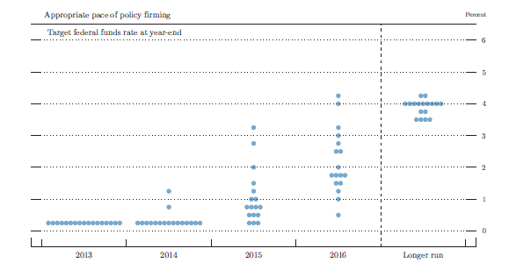
Most FOMC participants expect relatively modest tightening. Notice difference between long-run and 2015. Just when does longer run arrive? In most members view – not until at least 2017.
Source: Board of Governors of the Federal Reserve System, December 18, 2013
http://www.federalreserve.gov/monetarypolicy/files/fomcprojtabl20131218.pdf

Slide 19
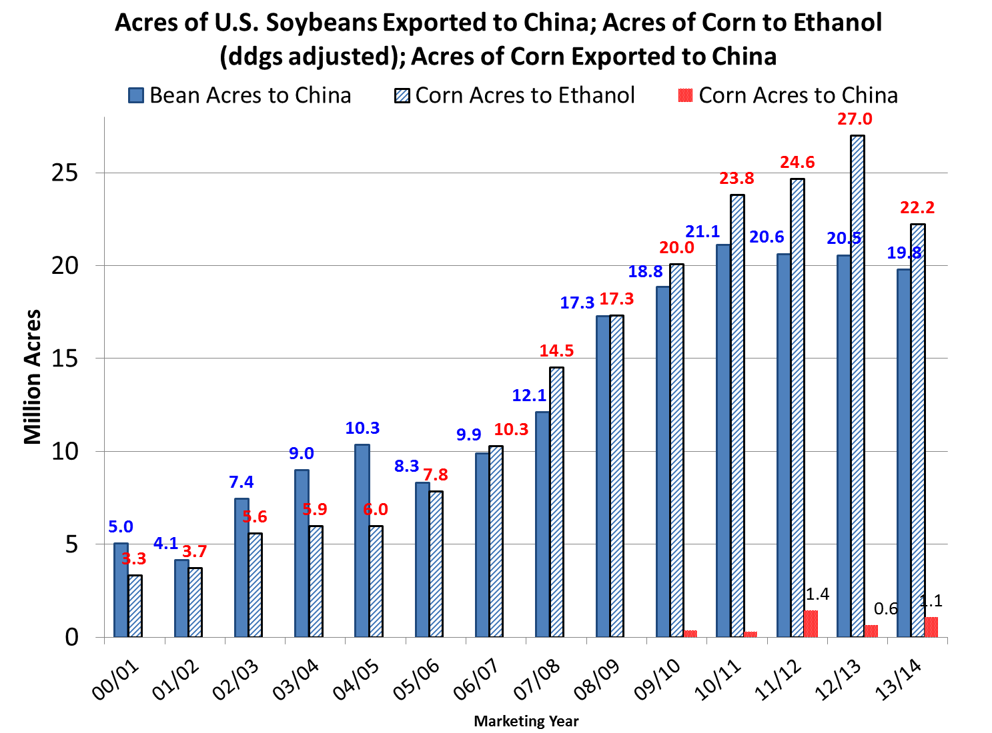
Demand expansion dramatically increased profitability

Slide 20
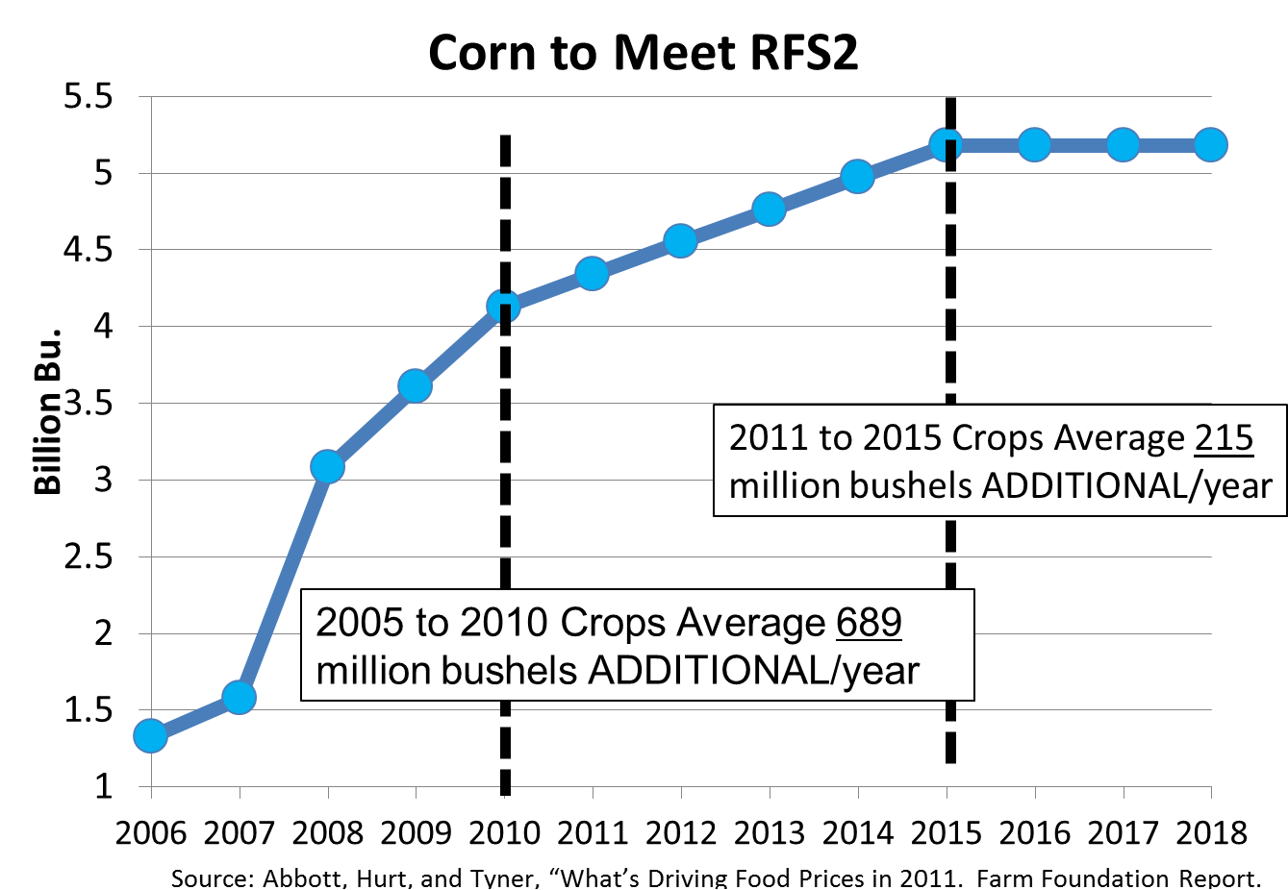
Big Demand Increases From Ethanol are Likely Over

Slide 21
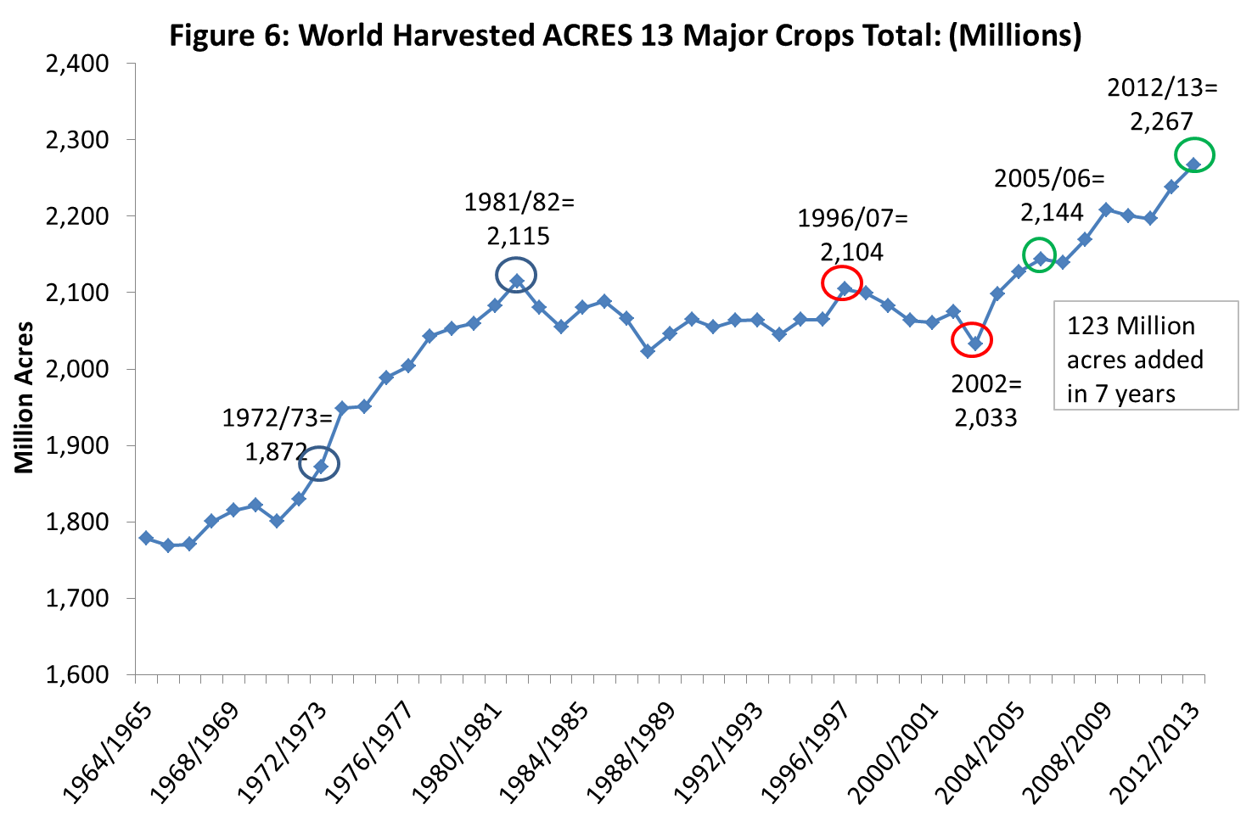
Acreage response is underway!

Slide 22
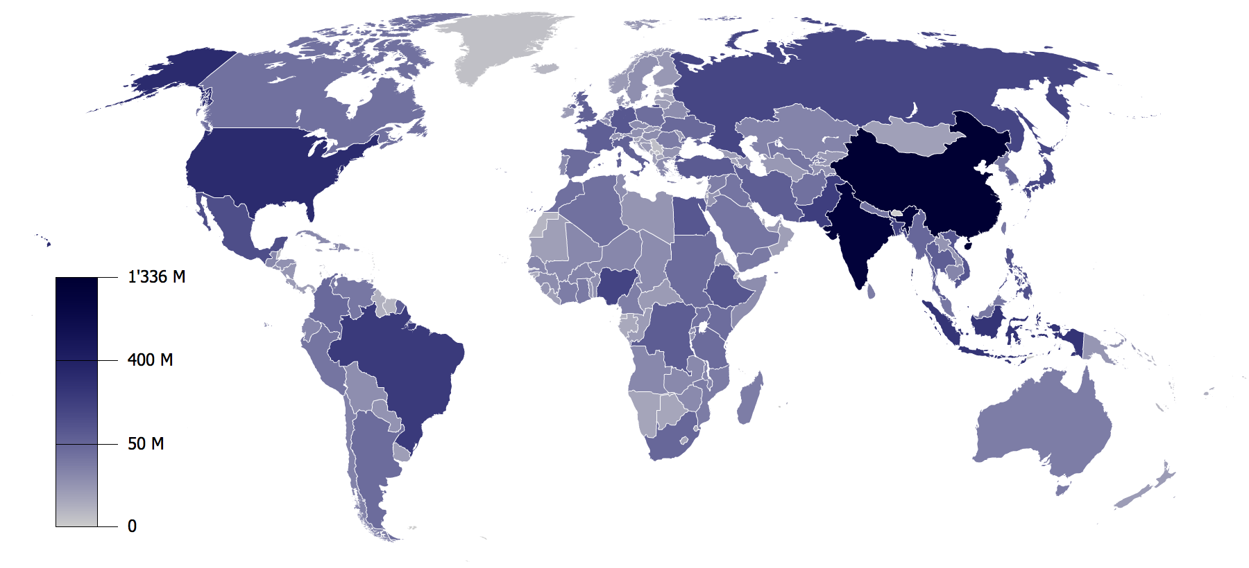
World Population by Country
Total population approximately 6.8 billion
Two countries hold 37% of the world’s population
U.S. Population = ?
China = ?
309 M
1.33 B
Country | GDP Per Capita (PPP) | % of World Total
U.S. | $46,716 | 21%
China | $3,263 | 11%
India | $1,068 | 5%

Slide 23
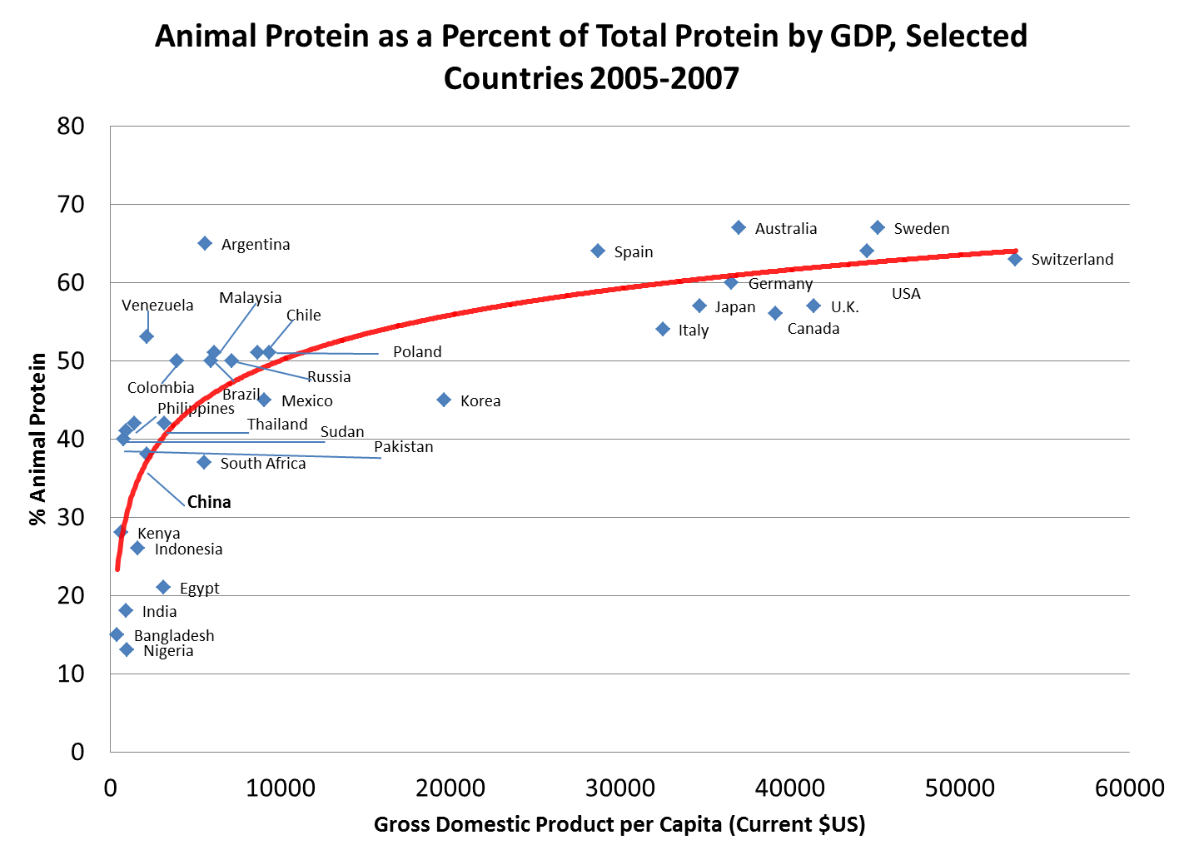
Will this be enough to keep us from building substantial stocks?

Slide 24
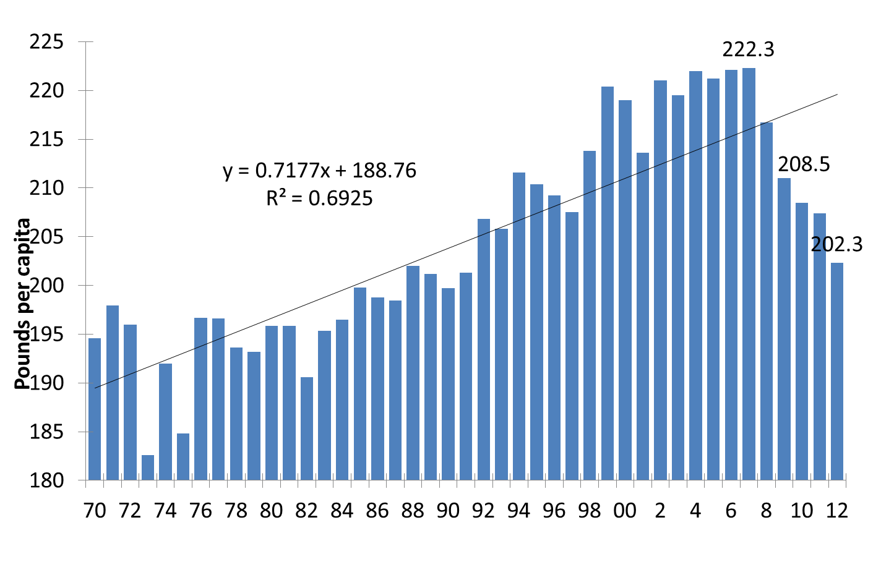
Per Capita Total Meats and Poultry Retail Weight: USDA
Department of Agricultural Economics Purdue University

Slide 25
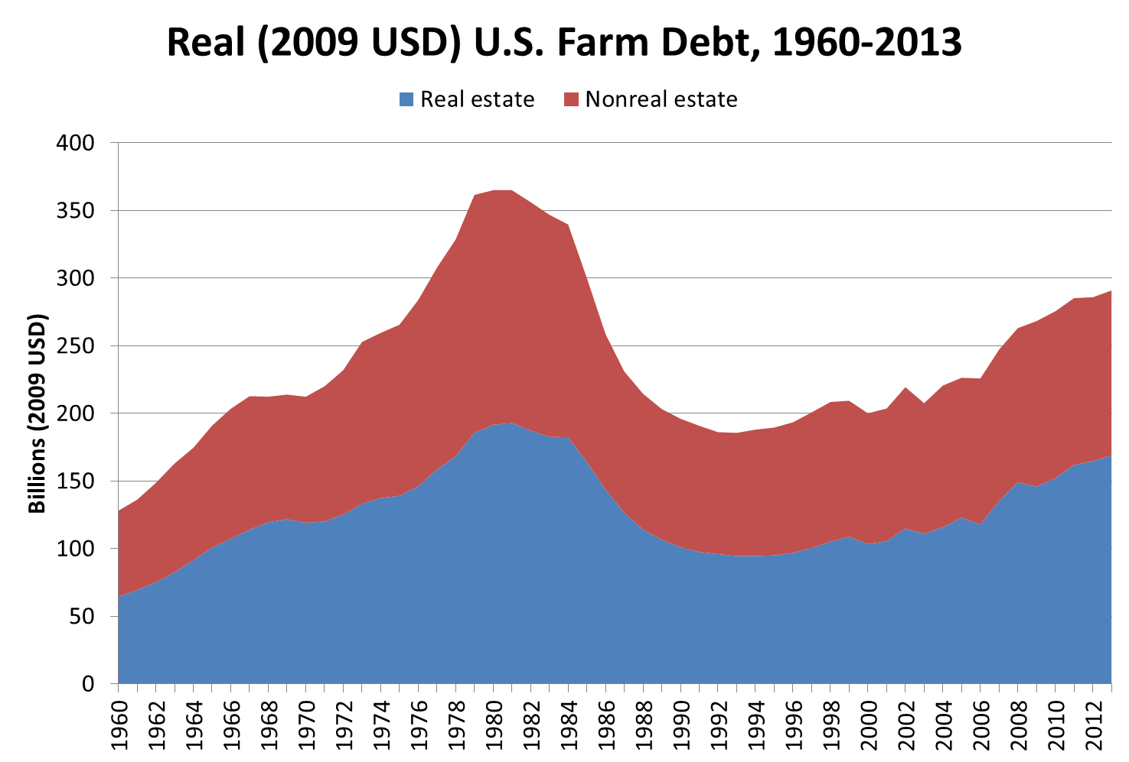
Notes:
From 70 to 81 total debt increased 72%
From 2002 to 2013 it increased 33%
2001 to 2013 up 43%

Slide 26
New Farm Program Arrives Just in Time!
Will likely provide substantial income support if prices follow USDA forecast
For the some farms the payments could provide support at rates approaching $90/acre
In other words, we now have a decent idea about how bad prices can/could get
Interest rates are the big unknown

Slide 27
So Could We See Substantial Downward Movement in Land Prices?
From average values – some downward movement
From extreme values – significant downward risk

Slide 28
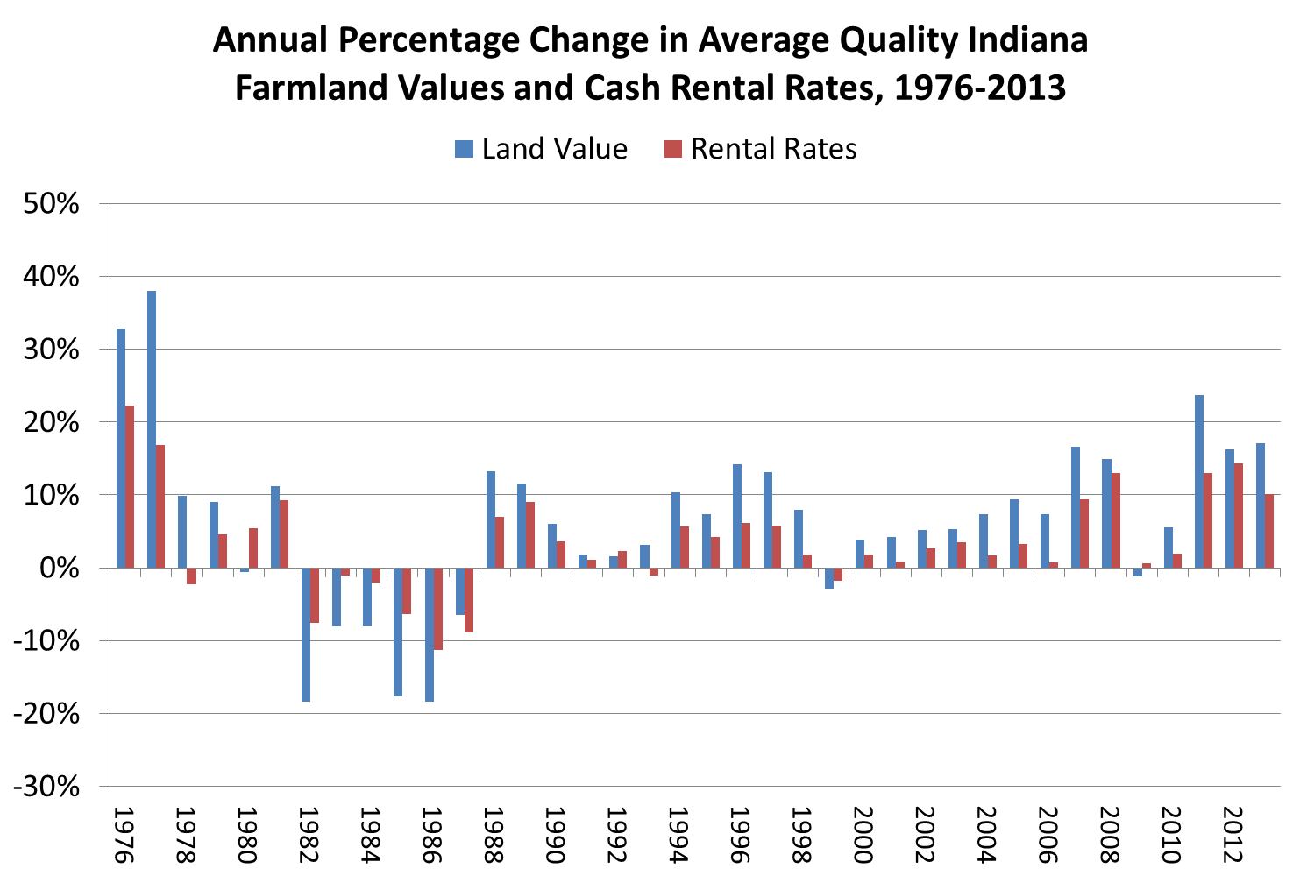

Slide 29
How Do You Arrive and Stay at $15,000 per Acre for Farmland?

Slide 30
One Option: Lower Prices and Lower Cap Rates
Example 1
(A) Corn Price $6.43
(B) Yield 200
Gross Revenue
  (A x B) $1,286
(D) Land’s share
of total revenue 35%
(E) Net revenue
for land
(C x D) $450
(F) Cap Rate 3%
(G) NPV for land
(E / F) $15,000
Example 2
(A) Corn Price $5.00
(B) Yield 200
Gross Revenue
  (A x B) $1000
(D) Land’s share
of total revenue 35%
(E) Net revenue
for land
(C x D) $350
(F) Cap Rate 2.3%
(G) NPV for land
(E / F) $15,000
Example 3
(A) Corn Price $4.50
(B) Yield 200
Gross Revenue
  (A x B) $900
(D) Land’s share
of total revenue 35%
(E) Net revenue
for land
(C x D) $315
(F) Cap Rate 2.1%
(G) NPV for land
(E / F) $15,000
More Optimistic than $6.40 Corn?

Slide 31
Another Option: Higher Share of Returns Go to Farmland
Example 4
(A) Corn Price $5.00
(B) Yield 200
Gross Revenue
  (A x B) $1000
(D) Land’s share
of total revenue 45%
(E) Net revenue
for land
(C x D) $450
(F) Cap Rate 3%
(G) NPV for land
(E / F) $15,000
Example 5
(A) Corn Price $4.50
(B) Yield 200
Gross Revenue
  (A x B) $900
(D) Land’s share
of total revenue 50%
(E) Net revenue
for land
(C x D) $450
(F) Cap Rate 3%
(G) NPV for land
(E / F) $15,000
Farmers Will Eventually Tire of This!

Slide 32
How do you turn $15,000 into $9,000?

Slide 33
How to turn $15,000 per acre into $9,000
At these share and cap rate combinations each $0.50 = $1,000 on farmland
Example X
(A) Corn Price $5.00
(B) Yield 200
Gross Revenue
  (A x B) $1000
(D) Land’s share
of total revenue 35%
(E) Net revenue
for land
(C x D) $350
(F) Cap Rate 3.5%
(G) NPV for land
(E / F) $10,000
Example Y
(A) Corn Price $4.50
(B) Yield 200
Gross Revenue
  (A x B) $900
(D) Land’s share
of total revenue 35%
(E) Net revenue
for land
(C x D) $315
(F) Cap Rate 3.5%
(G) NPV for land
(E / F) $9,000
Example Z
(A) Corn Price $4.00
(B) Yield 200
Gross Revenue
  (A x B) $800
(D) Land’s share
of total revenue 35%
(E) Net revenue
for land
(C x D) $280
(F) Cap Rate 3.5%
(G) NPV for land
(E / F) $8,000

Slide 34
Final Thoughts
Times have been VERY good
  It is conceivable they could get better
  It is also conceivable they could be worse
  It is very difficult to predict what takes us out of this cycle, but too much credit can magnify the outcome either way
Most signs point to slowing
  We wouldn’t bank on the next 7 years being as good as the last 7, but I think they will be acceptable for good managers

